Slide 1
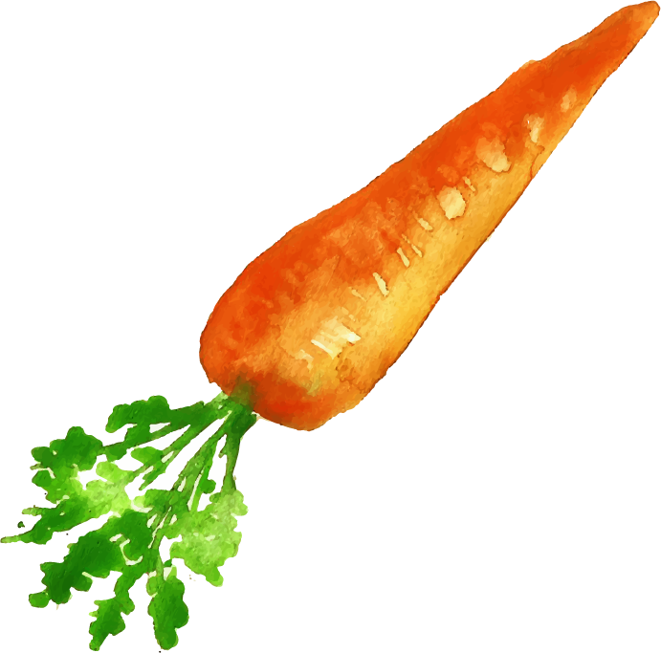








Food and Beverage Dashboard
Jean Paul Mitterhofer
Lyna Olivares
Baoxing Wang
Notes:
Intro
Brief intro of our food and beverage web dashboard

Slide 2

TABLE OF CONTENTS
01
02
03
Goals
About Data
Home Page
04
05
06
Comparison Page
Architecture
Dataset
07
Live Demo
Notes:
1. Our goals
2. Where we got our data
3. Homepage description layout
4. Comparison description layout
5. Architecture of our web app
6. Dataset
7. Our live demo

Slide 3

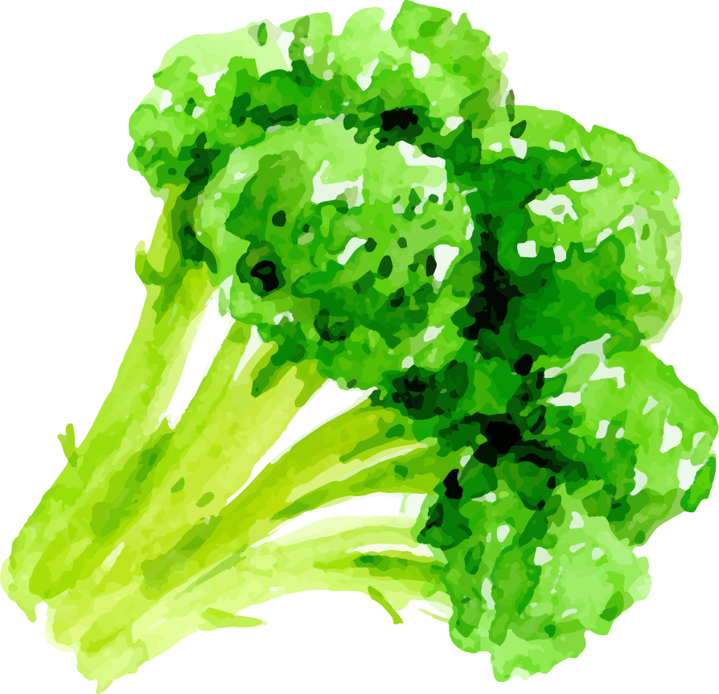

OUR GOALS
Individual Macro Micro Nutrient make up
Correlation between calories and macro nutrients
Comparison of two different food/beverage
Notes:
We all love food.
We all, at one point or another, in our lives, were food conscious
We are curious of what goes inside the food we eat, and what it can do
So we would look into the back labels of the foods we would buy and see how much
Our purpose is to visually and quickly show what nutrients make up a particular food or beverage:
That way you’ll know if one particular desert is a ball of fat or another contains the calcium, potassium, or iron you need for your body
1.To have a selection of a variety of foods. Make one selection, and see the individual macro and micro make up of that particular food or beverage.
2.Have a category of all the foods in our database and find a correlation between fat, protein, carbs and sugar to calories
3.And finally a comparison of two different foods or closely similar foods to see exactly what are the differences.

Slide 4

ABOUT THE DATA
The USDA Food and Nutrient Database for Dietary Studies (FNDDS).
Notes:
FNDDS is a database that provides the nutrient values for foods and beverages reported in What We Eat in America, which is an integrated national survey.
FNDDS database was in access form and in excel. We grabbed the excel form and did a bit of data munging since most of the data was already formatted.

Slide 5

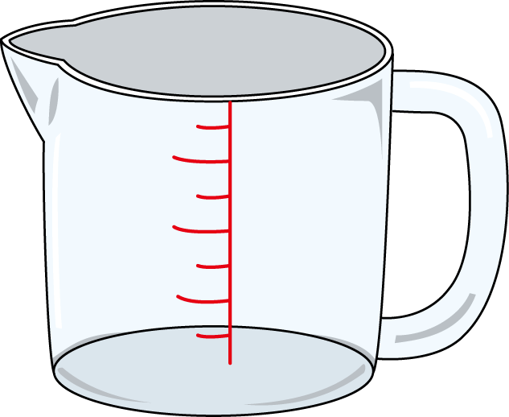





Dash Home Page Layout
FOOD DESCRIPTION
PORTION SIZE
6 Visuals
Table
Gauge
2 BarCharts
2 Radars
CATEGORIES
1 Visual
Scatter Plot
Selection
Selection
Dairy
Other
Bakery
Meat & Eggs
Fruit & Vegetables
Grains & Seeds
Notes:
Describe the layout of ou page:
Home page consist of two selections:
First selection is the standard pick a unique food and then pick the portion size you want.
Second, is the category selection

Slide 6
Dash Comparison Page Layout
Selection 1
Selection 2
FOOD DESCRIPTION
PORTION SIZE
FOOD DESCRIPTION
PORTION SIZE
8 Visuals
2 Tables
2 Gauges
2 Combined Radars
2 Combined Bar Charts
Notes:
1.SIde-by-side food selection and portion size selection

Slide 7


ARCHITECTURE
Flask App
Database
RESTful API
Front End
Notes:
Setting up a database using Postgres, connecting using SQLalchemy and Flask to create our API’s. Using the API’s to pull the data using javascript and display it on our Dashboard html and Dash Comparison html

Slide 8
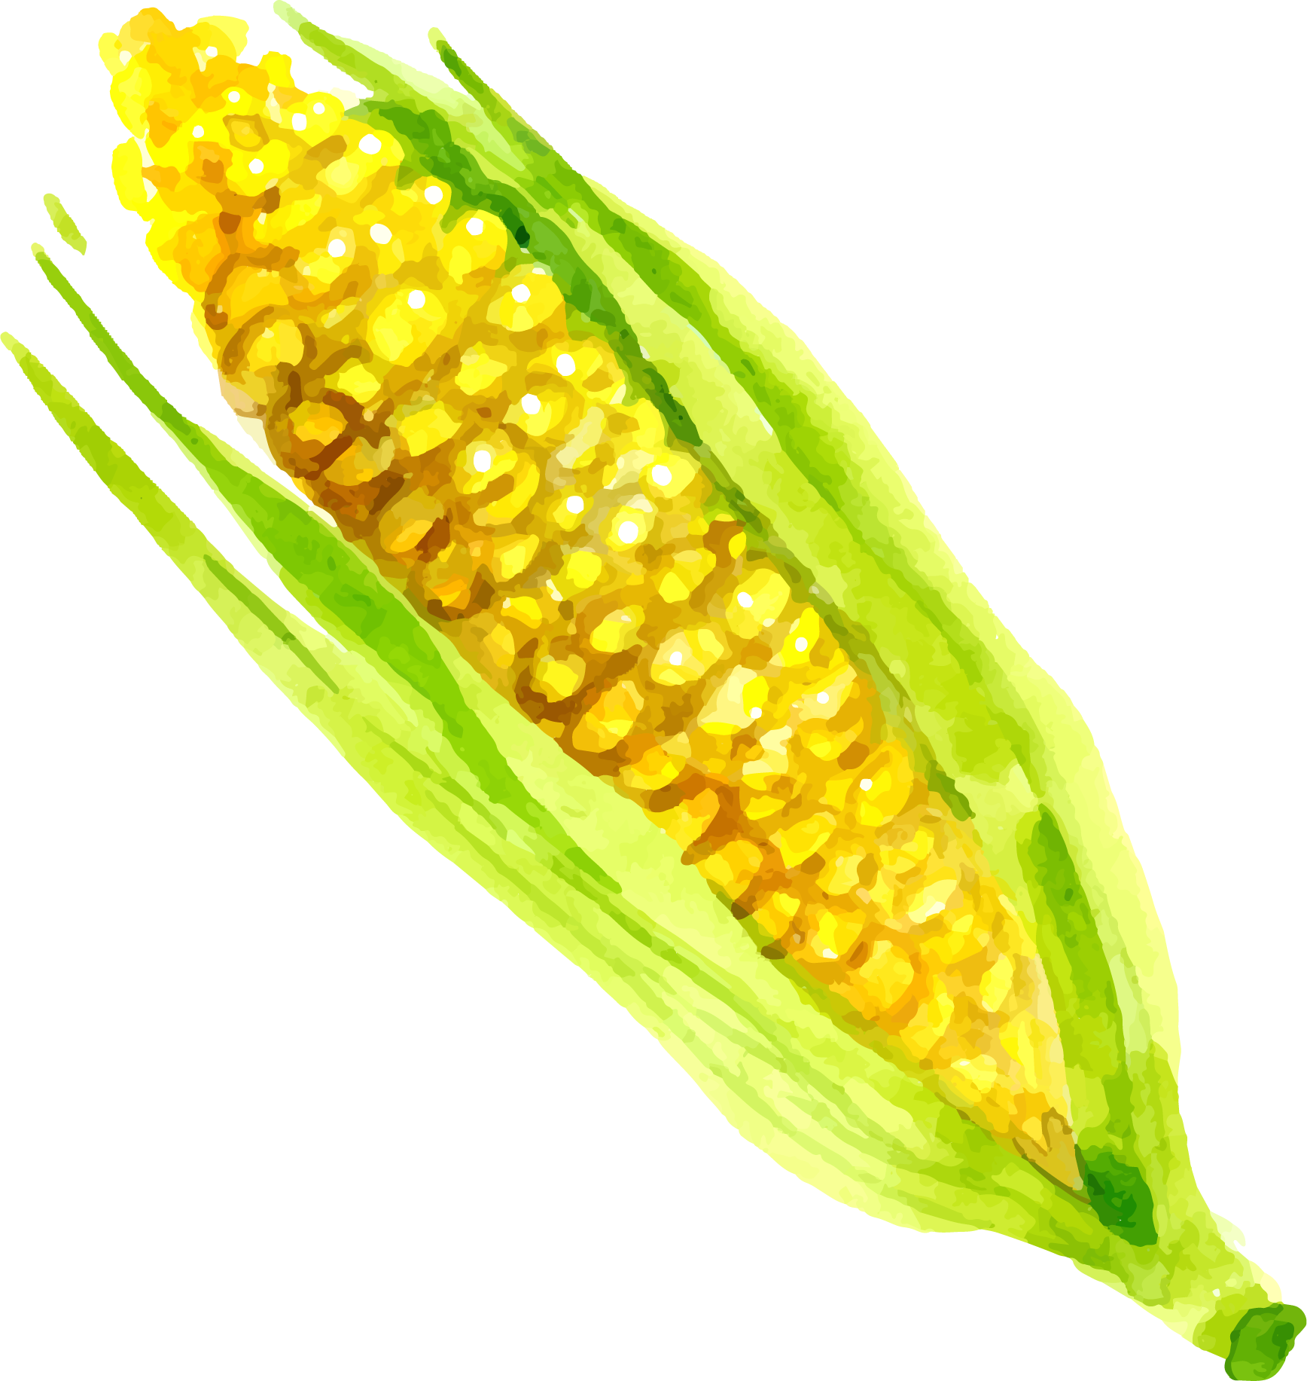
Dataset
All unique foods in our Database
Live Demo Budget
8,690
443
596 Dairy
1,854 Meat & Eggs
2,287 Fruits & Vegetables
842 Grains & Grains
899 Bakery
2,212 Other
Dairy
Notes:
When you include the different portion sizes, that’s 39,718 records.
For the live demo we shall,we shall run 443 records from our database selection of individual foods.
Pulling the full amount of data slows down the application considerably.

Slide 9

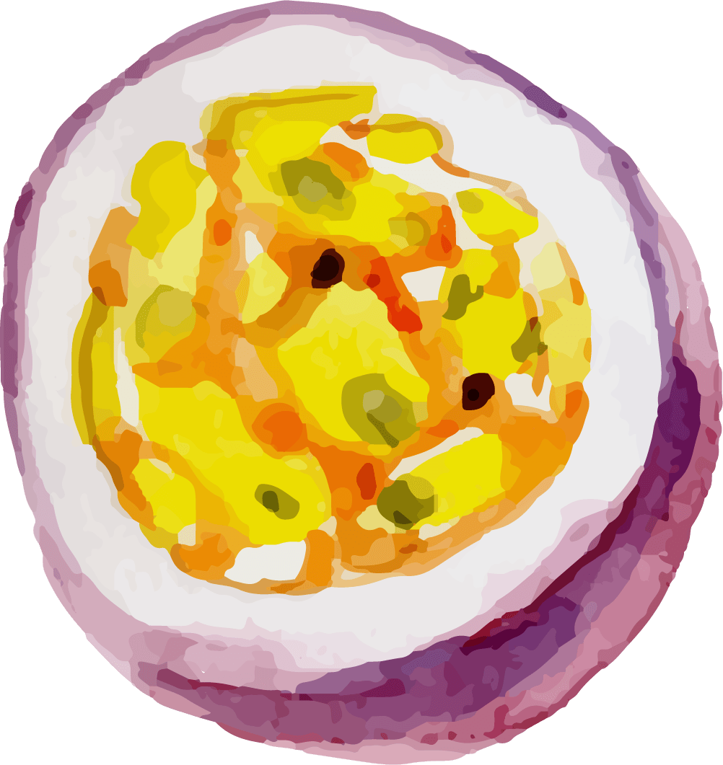
Live Demo
Lyna Olivares
Baoxing Wang
Notes:
Have app already running

